Slide 1
Technical Support (420-1N6-AB) Data Prioritization: Chipsets, CPU and RAM
Fall 2023 Adapted for Fall 2024

Slide 2
Outline
Test 1 review
The main hardware components:
CPU
RAM
Storage

Slide 3
Test 1 review
(on whiteboard in-class). Questions covered/average grade:
1.3: 50% | 5.3: 44% | 1.9
1.4: 57% | 5.4a: 26%
1.5: 57% | 5.4b: 16%
1.7: 50% | 5.5: 59%
1.10: 33% | Anything else?
2.3: 67%

Slide 4
Overview: How Hardware uses Logical Circuits
Last week we learned about how information is represented in computer systems (binary, logical circuits).
In particular, we saw how simple switches could be used to represent AND, OR, XOR, NOT, and similar logic in electrical devices.
Combining these simple “gates” to produce more sophisticated devices allows computer engineers to created Integrated Circuits (ICs), or, as we more commonly call them, Chips.
We now know enough to learn finish learning about some of the most important computer hardware components:
Chipsets
Central Processing Unit (CPU)
Random Access Memory (RAM)

Slide 5
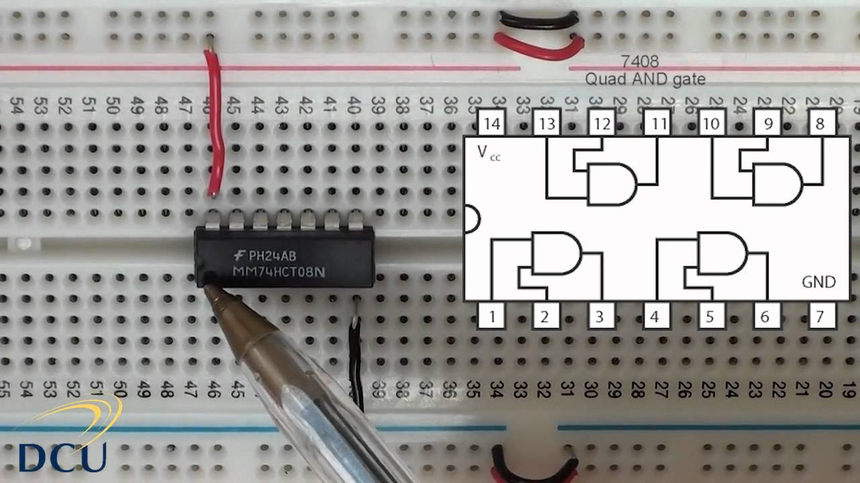
Logic Gates -> Integrated Components (Chips)

Slide 6
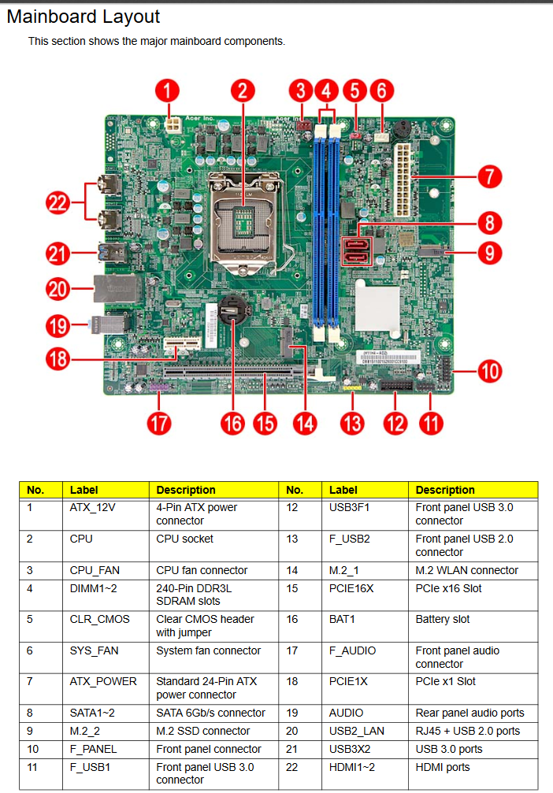
Integrated Components (Chips) -> Motherboard
Acer T3-710 Motherboard Schematic -- composed of many integrated components

Slide 7
Chipsets -- How Motherboards control computer communication

Slide 8
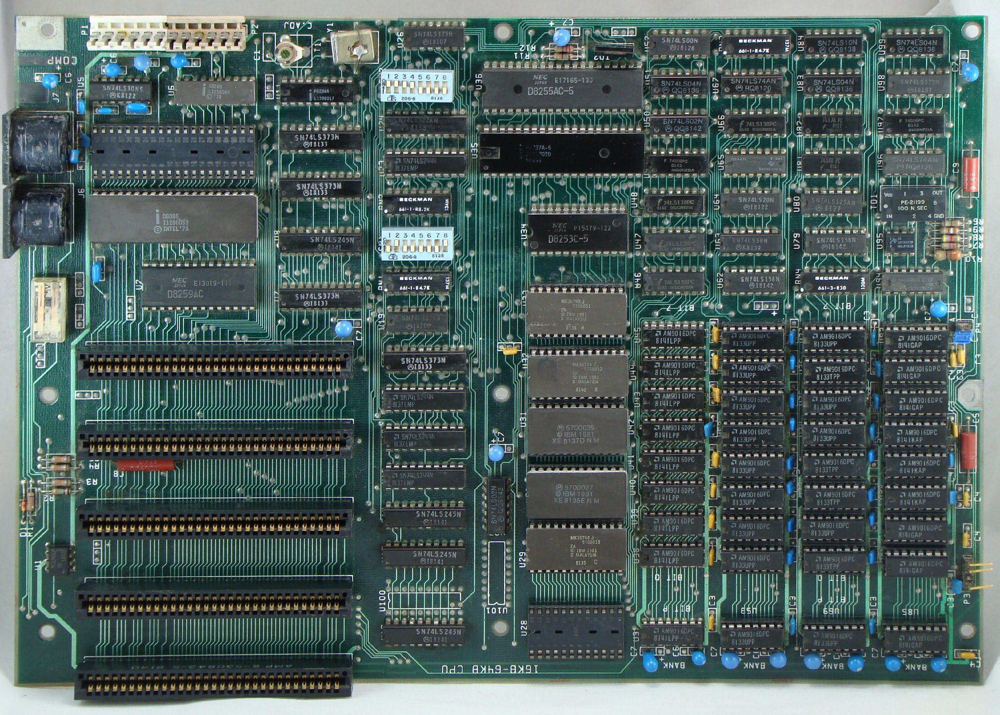
History
Older motherboards were designed with a lot of different chips scattered all over the motherboard.
There would be a separate component for each hardware device connected to a motherboard:
CPU controllers
RAM controllers
keyboard/mouse controllers
Graphics controllers
Speaker controllers
etc!
Most of these chips do the same thing! (process requests for hardware commands)

Slide 9
How did Chipsets Evolve?
As technology progressed, computer engineers decided to reduce the number of chips and have them more in a centralized location so instead of having these different chips scattered all over the motherboard controlling different functions.
The number of chips was reduced to few chips that do the same job or what's now called a chipset.

Slide 10
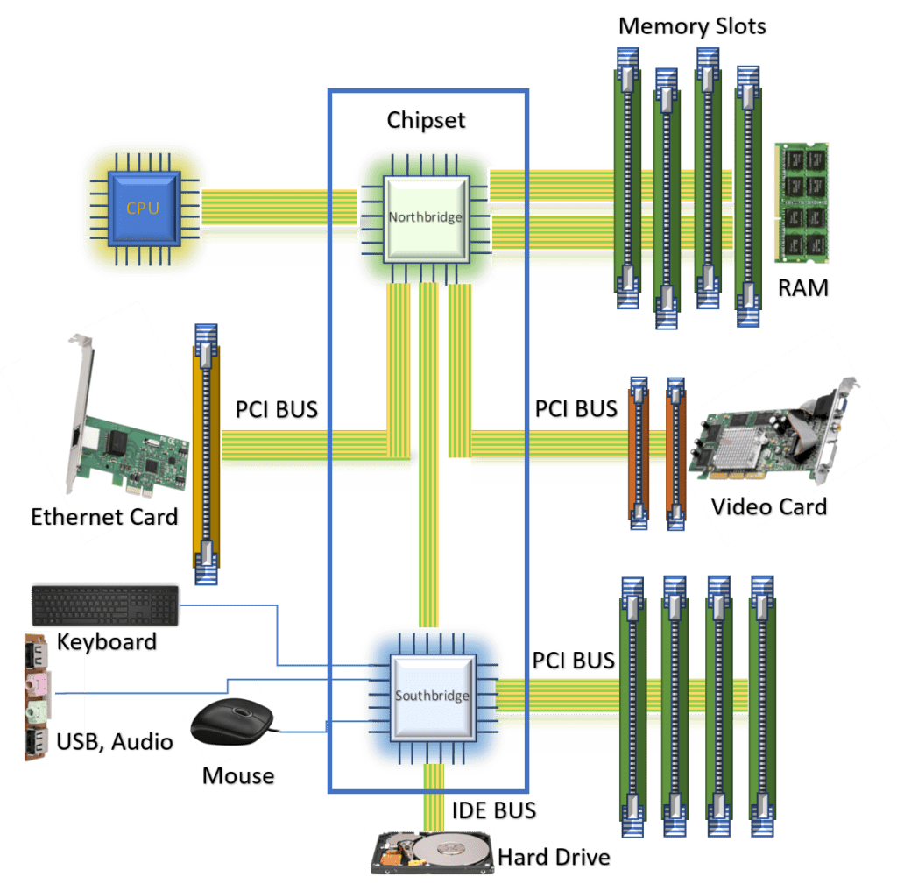
The chipset
Result: the motherboard chipset, grouped into two main components:
Northbridge (high speed)
Southbridge (everything else)
https://www.baeldung.com/cs/chipset

Slide 11
So.. What is Chipset?
A chipset is a smaller set of chips that has replaced a larger amount of chips.
Chipsets job is to control data flow between the CPU, the peripherals, bus slots, and memory.
All the different computer hardware components communicate with the CPU through the chipset.
Most chipsets are divided into two distinct components:
Northbridge
Southbridge

Slide 12
Northbridge Chipset
Directly connected to the CPU, main memory, graphics card and PCI-Express.
Connection between the northbridge and CPU is known as the frontside bus.
Any communication between the above components must go through the northbridge first.
To communicate with any other components, the communication goes through the northbridge then the southbridge.
Northbridge is faster than the southbridge.
Why? Northbridge is optimized for speed (actions per second) since it connects the most used and most important components of the motherboard.
Faster actions per section comes at a cost! The Northbridge is a source of heat and needs to be placed by heatsinks and fans.
These days, the Northbridge is often directly a part of the CPU, while the Southbridge remains separate.

Slide 13
Southbridge Chipset
Connected to the northbridge.
Acts as a communication hub for less performance sensitive components.
Storage devices (SATA and IDE connectors).
PCI bus slots.
I/O Ports (USB ports, networking, sound card, etc.)
Southbridge does not require high speed communication like the northbridge.
To send data from the hard drive to the main memory:
Data goes to the southbridge.
Southbridge sends the data to the northbridge.
Northbridge will send the data to the main memory.

Slide 14
Modern Motherboards and Chipsets
Modern chipsets integrate the northbridge chips within the CPU chip.
New design advantages:
Sensitive hardware components communicate directly with the CPU.
Reduces system latency.
Increases system responsiveness.
Less sensitive hardware components will increase in performance.

Slide 15
Bus Width: x86 versus x64

Slide 16
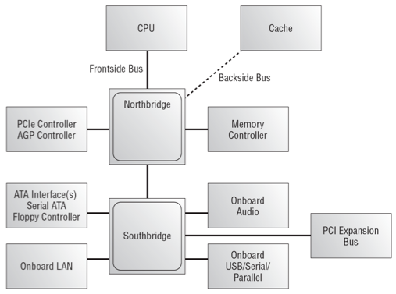
The chipset
When we speak about the motherboard bus width, we often refer to the frontside bus

Slide 17
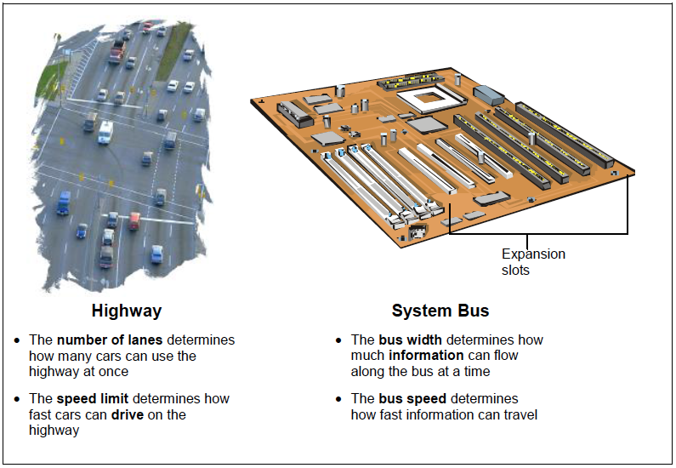
Why is the bus important?
You can double check that you understand a scientific concept by checking what units of measurement that concept is measured by:
Highway
Number of lanes: (a number)
Speed limit: (unit distance per time elapsed, e.g. km/h)
System bus
Bus width: (a number of bits, eg a 32-bit processor)
Bus speed: (unit information per time elapsed, e.g. bits/second)

Slide 18

Highway analogy
There's 6 lanes (6 cars can pass together)
On each lane, 3 cars are passing per second
How many cars are passing per second on this highway?
Notes:
Answer: 6 lanes x 3 cars/second/lane = 18 cars/second.

Slide 19
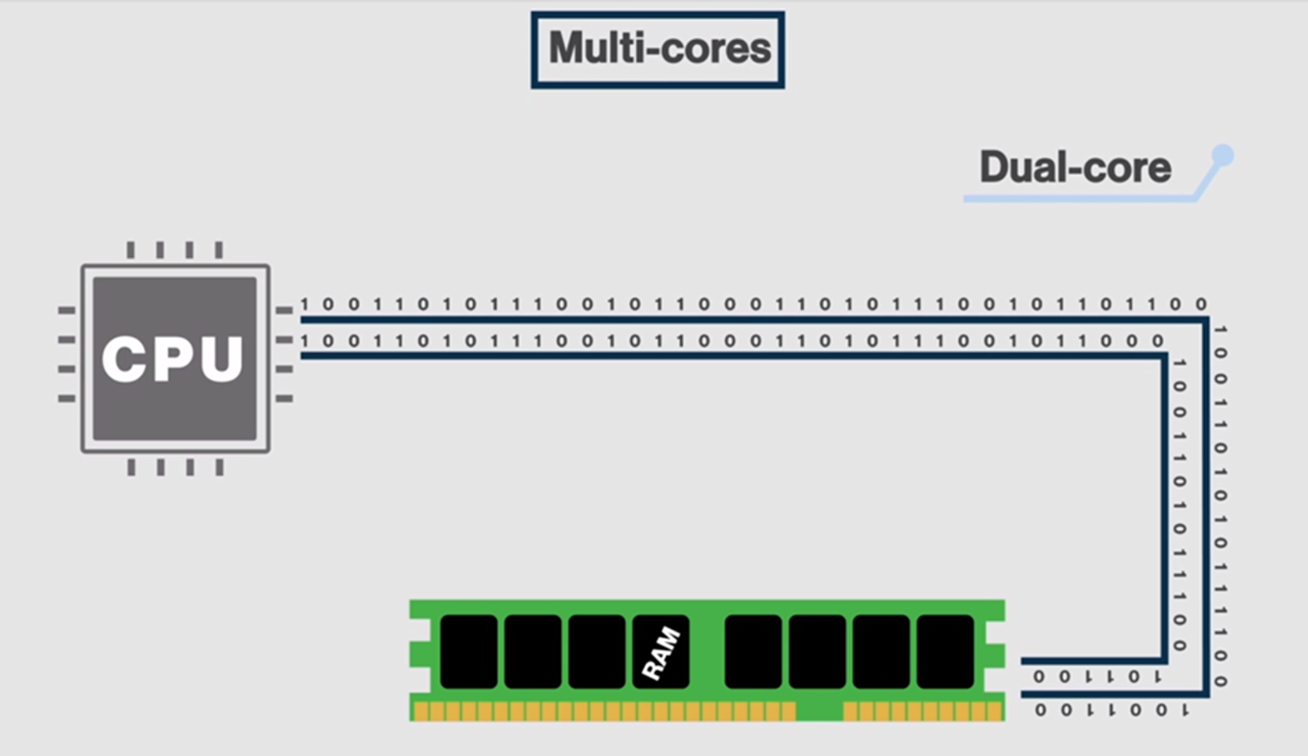
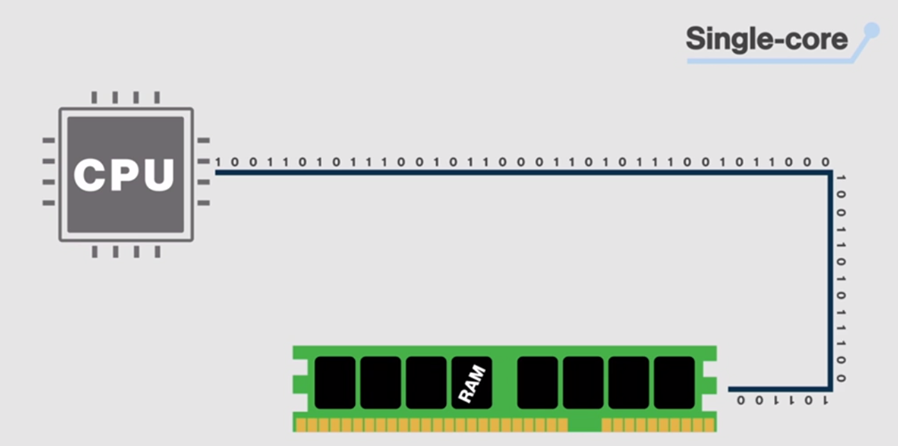
x86 versus x64
x86
x64
32 bits can travel at once in our system components
2^32 ≈ 4 Billions bits at once
64 bits can travel at once in our system components.
X64: 2^64 ≈ 4 Billions x 4 Billions bits at once.7

Slide 20
x64
Almost all modern hardware and software are x64
64-bits system offer better system security
64-bits system offer better graphics performance
But! You might still need to support 32-bits (old softwares,etc).

Slide 21
Central Processing Unit

Slide 22
Central Processing Unit (CPU) - Reminder
Most important element of the computer in terms of computing power.
Brains of the computer.
Responsible for interpreting and executing the commands from the software.
The processor executes a program (sequence of stored instructions).
While the CPU is processing one step of the program, the remaining instructions and the data are stored in a special memory called cache.
Almost all modern devices include a CPU:
Desktops, laptops, tablets, smartphones, TVs, TV boxes, Vending machines, traffic lights, Smart devices (Fridge, washer, light bulbs)

Slide 23
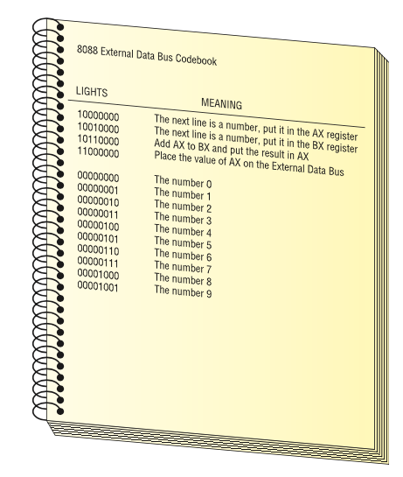
CPU Reminder (Lecture 4)
10000000 The next line is a number, put it in the AX register 00000010 The number 2 10010000 The next line is a number, put it in the BX register 00000011 The number 3 10110000 Add AX to BX and put the result in AX 11000000 Place the value of AX on the external data bus
A set of commands such as this is called a program. A program is a series of command sent to a CPU in a specific order for the CPU to perform work.

Slide 24
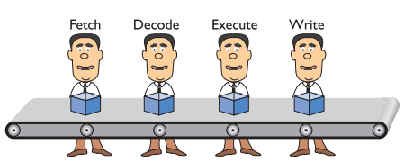
Pipelining - Reminder
The CPU takes at least four stages (fetch, decode, execute, write/repeat) to do something. See https://en.wikipedia.org/wiki/Instruction_cycle for more detail Small discrete circuits inside the CPU handle each of these stages.
By organizing these circuits in a conveyor-belt fashion (called pipelining), our “man-in-a-box” becomes “men-in-a-box”, thus improving efficiency.
Helps system to run faster. Not perfect and sometimes stalls. Some CPUs therefore have multiple pipelines.
Notes:
More efficient while one is busy doing something, you can let others work on the following steps.

Slide 25
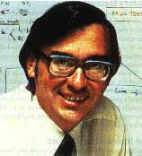
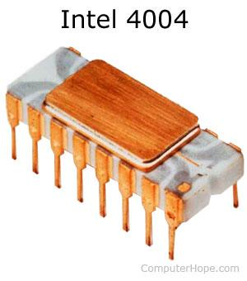
CPU History - Reminder
First CPU: Intel 4004 processor:
Developed at Intel Corp by Ted Hoff.
Introduced in 1971.
Design:
108 kHz (2,300 transistors).
Performed 60,000 OPS (operations per second)
Addressed 640 bytes of memory.
Cost $200.00.

Slide 26
CPU Manufacturers - Reminder
Intel and AMD are the two most popular manufacturers of CPUs for desktops, laptops, and servers.
NVIDIA, Qualcomm, Samsung and Apple are major manufacturers of mobile CPUs.
Used in smartphone, tablets, TV boxes, etc.

Slide 27
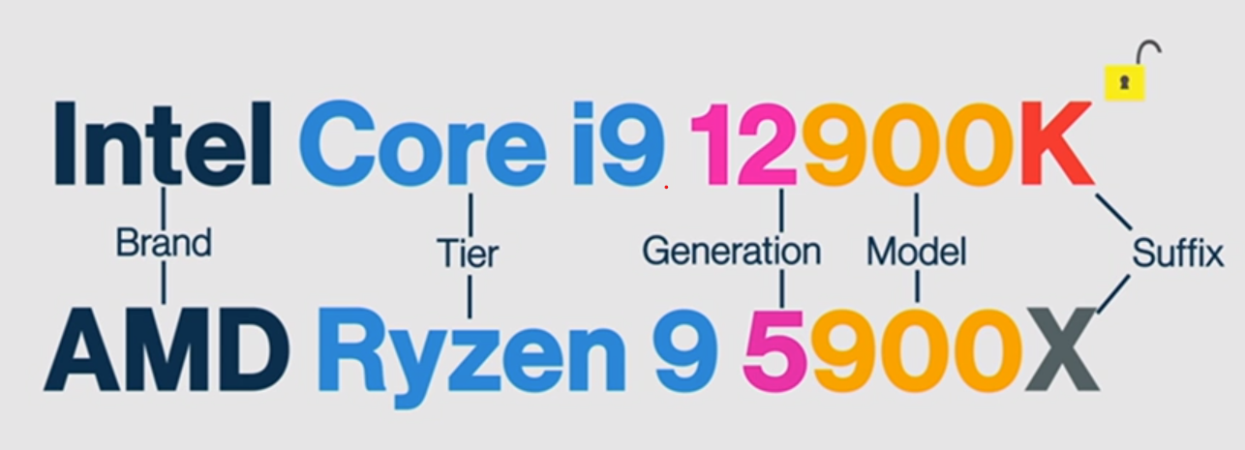
CPU Manufacturers - Reminder
Notes:
Core i9 > Core I7 => higher tier
The higher the generation, the newest the CPU and contains more of the latest technology
The model number will uniquely idenfied the CPU in terms of its performance
Letters could indicate many different things, for example "K" for Intel is no limit for over-clocking, it's unlocked.
"X" for AMD means the CPU comes out of the box, already over-clocked.

Slide 28
CPU Architecture

Slide 29
CPU Components
There are two primary components for a CPU:
Arithmetic Logic Unit – ALU (introduced in Lecture 5):
Performs basic arithmetic calculations like adding, subtracting, multiplication and division of numbers.
Performs logical operations like the comparison.
Control Unit – CU:
Controls all operations taking place within the processor.
Instructs the ALU on which arithmetic/logical operation is to be performed.
Acts under the direction of the system clock.
Sorts out all the internal data paths inside the processor to make sure that data is fetched from the right place and delivered to the right place.

Slide 30
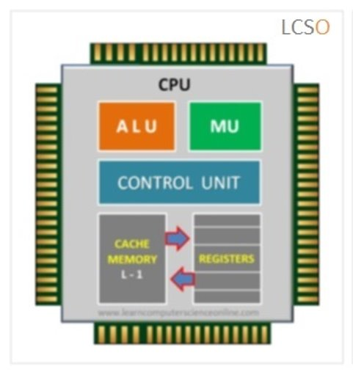
Other CPU Components
Registers: a temporary storage used to store data:
Coming from memory heading to the processor for execution.
Coming from the processor after processing
Being worked on by the processor.
Internal Data Bus: connects the internal components of the processor to the motherboard.
External Data Path: used to fetch data from memory to the processor.
Address Lines: used to specify the exact location in memory where data can be found.

Slide 31
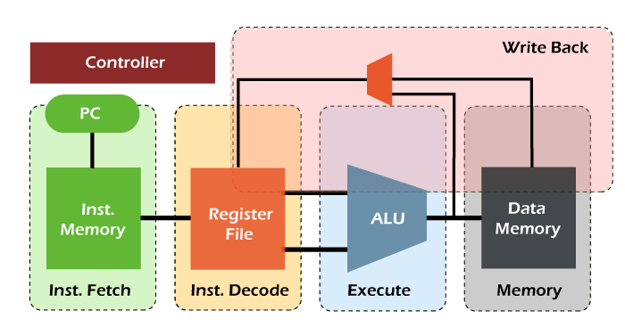
Pipelining
A way for running multiple instructions in parallel within the same processor core.
Fetch: refers to the step where the instruction is received from Memory
Decode: The instruction is decoded, and control signals are generated .
Execute: ALU operations are performed.
Memory: Saving the output to the appropriate memory address

Slide 32
CPU Power
CPU power is measured by both speed and the amount of data it can process.
Speed: is rated in cycles per second, e.g. megahertz (MHz) or gigahertz (GHz).
Hertz (Hz) is the unit of measurement that represents the idea “per second”. So MegaHertz (million Hertz) means “one million times per second”
The amount of data processed at a time depends on the side of the FSB (front side bus) (also called CPU or processor bus).
The width of a bus is measured in bits, e.g. 32-bit or 64-bit FSB.

Slide 33
CPU Features

Slide 34

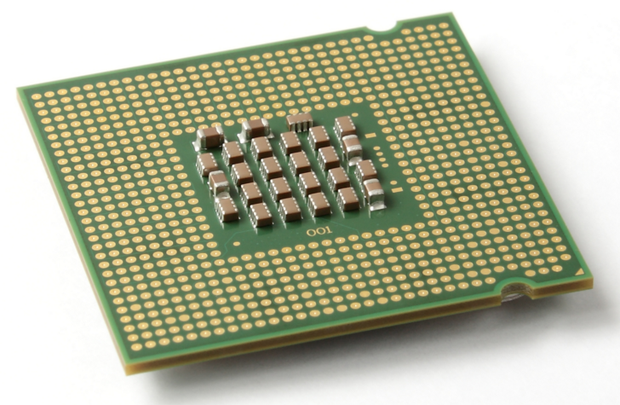
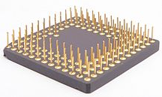
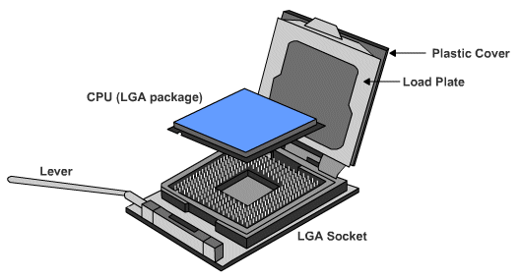
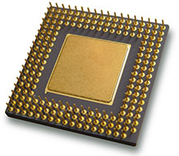
1) How to Connect a CPU?
CPU connection on the motherboard is known as the CPU socket.
The CPU is connected to the motherboard in one of two ways:
Pin Grid Array – PGA
Pins are on the CPU (underside of the processor).
Socket on motherboard includes holes that line up with the CPU pins.
Land Grid Array – LGA
Pins are on the motherboard (on socket) instead of on the processor.

Slide 35
2) Clock Speed (overclocking and throttling)
Overclocking: a technique used to make a processor work at a faster speed than its original specification (not recommended).
Throttling: when the processor runs at less than the rated speed to conserve power or produce less heat (commonly used in laptops and mobile devices).

Slide 36
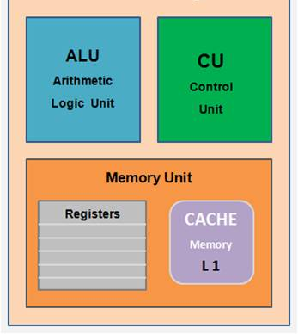

3) CPU Cores
Multi-Cores: More than one CPU core integrated into a single chip, each capable of running parallel processes
Each core has its separate ALU unit, control unit and Registers.
1010101101011010110
10101010101010100101
1010101101011010110
1010101010101010010

Slide 37
3) CPU Cores
Single Core
Multi- Core
The CPU can accept instructions from one data "lane" at a time.
A Dual-Core CPU is a CPU with that can manage two lanes of data travelling to the RAM at the same time, in parallel.
4 lanes ==> Quad-core, etc.

Slide 38
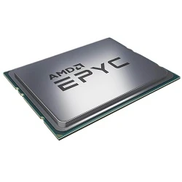
3) CPU Cores (The threadripper)
Threadrippers are CPUs with 32 and even 64 cores.
AMD EPYC 75F3 2.95 Ghz, 32C/64T 256 M Cache (280W)
Costs 15 699.00 CAD $
Purpose: for servers, for managing many users at the same time.

Slide 39
4) CPU Cache
The CPU store the most recently used data and instructions in its cache.
This speeds up the processing as the cache is much closer to the ALU unit and increases the performance greatly.
The CPU Cache is also RAM (Random Access memory) but static RAM.
RAM comes in two types: dynamic RAM (DRAM) what is used in the Main Memory and static RAM (SRAM) which is used in the CPU Cache.

Slide 40
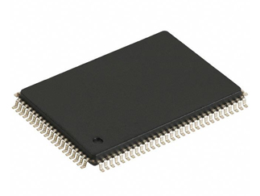
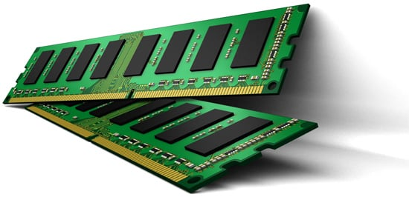
SRAM vs DRAM
Static RAM
Dynamic RAM
Uses transistors memory cells.
No need for power refreshing to keep data
Low power consumption
Very expensive ≈5000$/Gb
Very fast read/write
Volatile (data erased at power off)
Only a few MB used in a PC
Uses transistors and capacitors
Power refreshing required to keep data saved
Higher power consumption
Good balance price/amount ≈20-75$/Gb
Fast, but not as fast as SRAM
Volatile (data erased at power off)
4-32GB of RAM used in a PC

Slide 41
4) CPU Cache
Static RAM comes into three different caches :
L1 cache: internal cache, very fast, integrated inside each CPU Core ≈ 16K - 2Kb/core
L2 cache: external cache, fast, every cores ≈128Kb – 8Mb/Core.
L3 cache: slowest cache, originally mounted on motherboard, now integrated into CPU chip, shared by all the CPU Cores ≈ 64MB

Slide 42
4) CPU Cache – Data flow
CPU Core
L2 Cache
128Kb – 8Mb
L3 Cache 64Mb
Main Memory
Registers
L1 Cache
16Kb
ALU
CU
CPU Core
L2

Slide 43
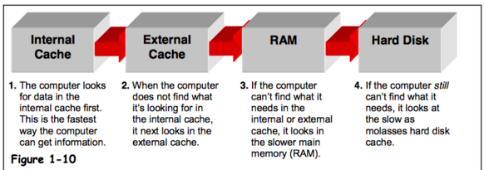
4) CPU Cache

Slide 44
Activity: Bus Speed and Bus Width (CPU Power)
How to choose a CPU?
Let’s say we have a 100-MHz, 32-bit bus CPU.
How many bytes per second can the CPU process?
Now, let’s compare the above CPU with a second 80-MHz 64-bit bus CPU.
How many bytes per second can the second CPU process? Which of the two is faster at sending information?
First CPU: 400 Mbytes/s Second CPU: 640 Mbytes/s
Power consumption of the first CPU is bigger due to the higher clock rate.

Slide 45
Other Types of CPUs

Slide 46
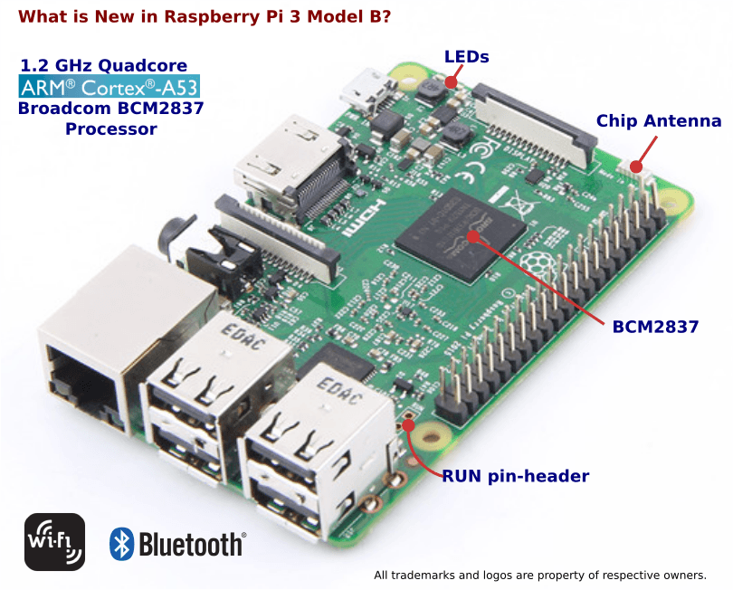
ARM Chip
Simplified CPUs called Advanced Risk Machine.
More simplified instruction set
Much higher speed of processing and reduced workload.
Used in Arduinos and RasberryPis
The Apple M1 Chip used in Macbook Air is an ARM chip

Slide 47
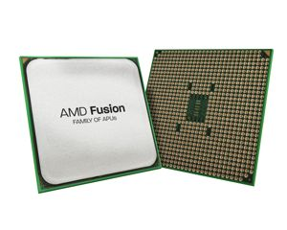
Accelerated Processing Unit (APU)
APUs are CPUs with combined graphics processing capabilities.
Not as powerful as a dedicated GPU.
Great option for budget gaming.

Slide 48
Main Memory

Slide 49
What is the Main Memory?
Referred to as RAM (Random Access Memory)
RAM is a collection of integrated circuits (chips).
Considered the “Primary” storage for the CPU.
Temporary storage for data and programs that are being accessed by the CPU.
Volatile memory: contents are erased when the computer is switched off. (or when power is lost)

Slide 50

Why use Main Memory?
Did you ever thought why games take time to load?
This is the time it takes to copy all the files of the game from the storage device (long term memory) into the working memory of the main memory, which the CPU can access must faster and much easier.
Read/Write speed in RAM is 12 800 Mb/s
Read/Write speed in SSD is 456Mb/s

Slide 51
Why use Main Memory?
More RAM means more capacity to hold and process large programs and files.
Maximum installed is limited by the motherboard and the operating system.

Slide 52
Main Memory History
Early computers had RAM installed on the motherboard as individual chips.
These were difficult to install and often became loose.
Designers and engineers then created memory modules.
Special circuit boards on which the memory chips are soldered on.
Memory modules are attached to a motherboard using memory slots.
New design allows to add or replace memory modules.

Slide 53
Main Memory Features

Slide 54
1) Data Rate
SDRAM
Original Main memory was the Synchronous Dynamic Random Access Memory (SDRAM)
It’s synchronized with the motherboard speed.
For a 32-bit bus, if the motherboard goes up to 100Mhz, the SRAM speed was also 100MHz x 32bits of data send/received.
DDRAM
The first leap in RAM technology was the Double Data RAM DDRRAM.
For every tick of the motherboard clock, DDRAM sends/receives 2 bits of information instead of just 1.
This “doubles” the speed: 2 x 100MHz x 32 bits

Slide 55
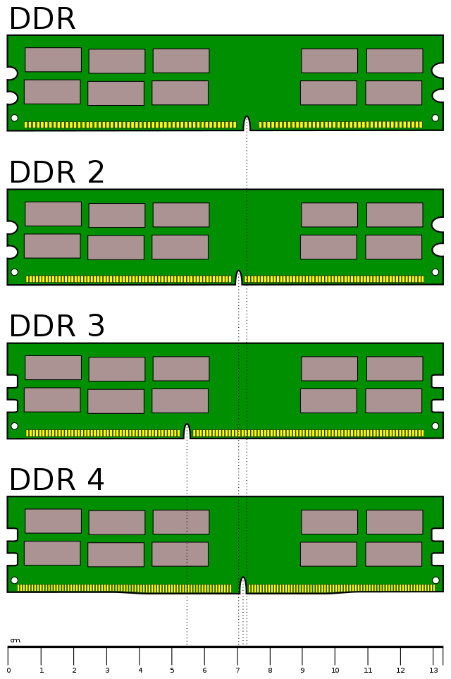
1) Data Rate
How can we make the difference between SDRAM, DDR, DRR2, etc.
The number of pins and the position of the notch
 | Number pins | Number notch | Clock Speed | DDR Speed | PC Speed (in bits)
SD-RAM | 168 | 2 | 100 MHz | SD-100 | PC-800
DDRAM | 184 | 1 | 100 MHz | DDR-200 | PC-1600
DDR2 | 240 | 1 | 100 MHz | DDR2-400 | PC2-3200
DDR3 | 240 | 1 | 100 MHz | DDR3-800 | PC3-6400
DDR4 | 288 | 1 | 100 MHz | DDR4-1600 | PC4-12800
DDR5 | 288 | 1 | 100 MHz | DDR5-3200 | PC5-25600

Slide 56
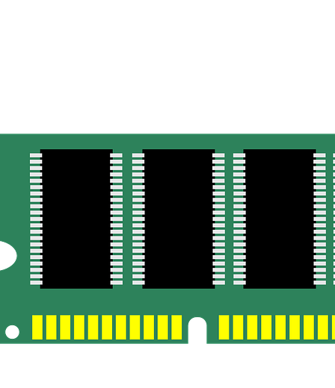
2) RAM Capacity
Every Stick of a RAM has a capacity (in GB) which is the amount of information that the RAM can store.
The capacity depends on the size of the chips (1Gb, 4Gb, 16Gb, etc)
The capacity depends if the RAM is SIMM or DIMM

Slide 57
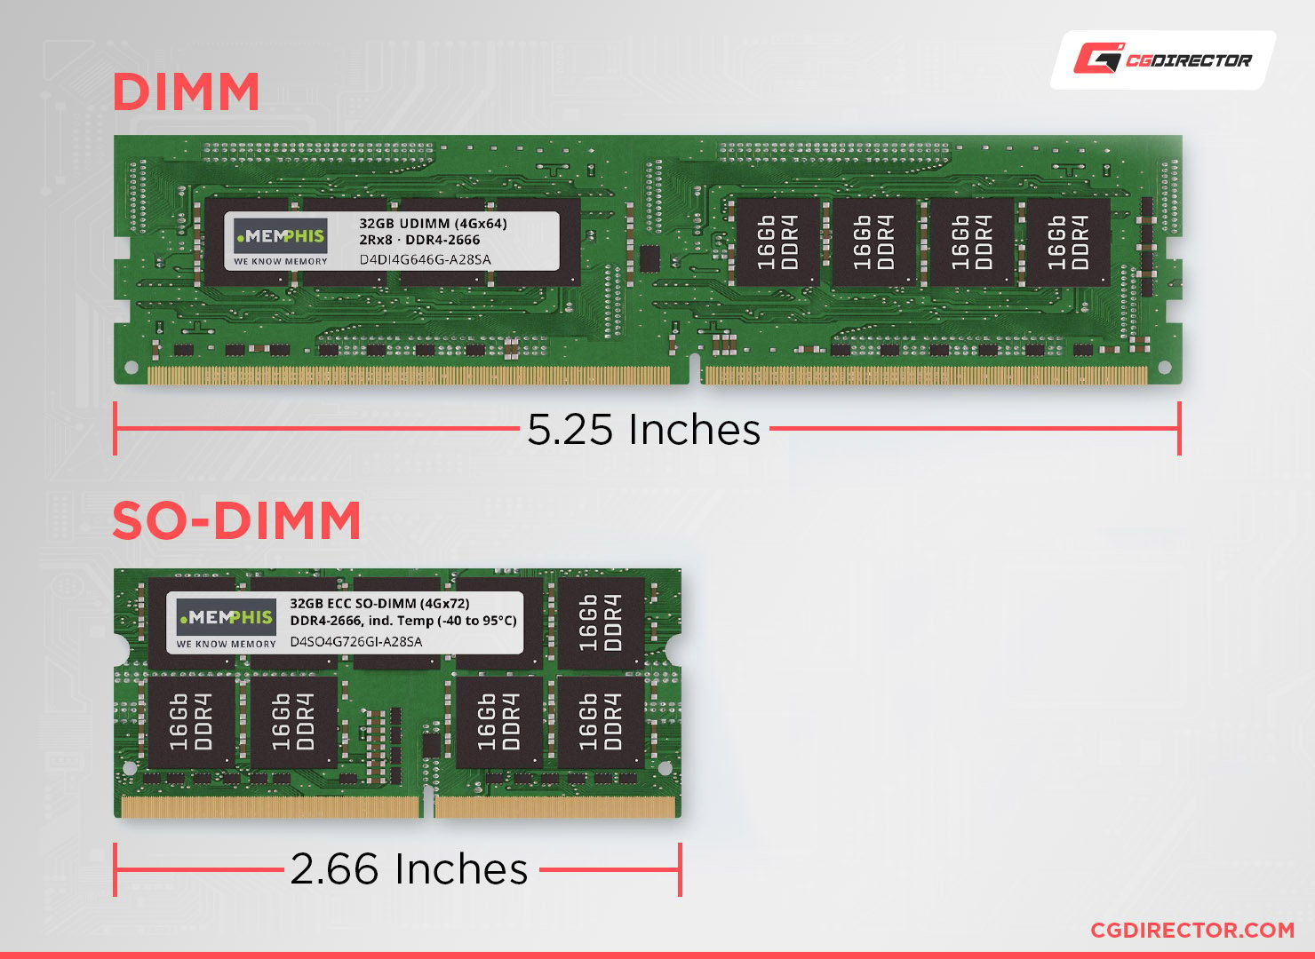
Serial Presence Detect (SPD)
How can we get all the specs of currently installed RAM sticks?
SPD chip which allows the system to query the RAM stick.
CPU-Z program is able to speak to the SPD to get all the specs of the RAM without you having to open your PC.

Slide 58
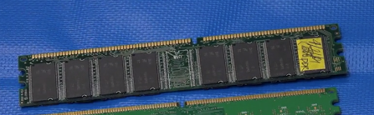
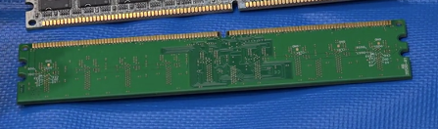

2) RAM Capacity: SIMM vs DIMM
SIMM (Single Sided)
DIMM (Double Sided RAM)
This allows the memory to be doubled on each side of the RAM stick 2Gb, 8Gb, …

Slide 59
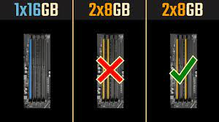
3) RAM Channel
Motherboards have limited RAM slots: usually 2 RAM slots, or 4 RAM slots
RAM is almost always sold in pairs of RAM Sticks
The Motherboards support channels (1 channel, 2 channels)
RAM should be identical in the
same channel
If you place the RAM sticks in the incorrect way on the motherboard, the dual channel will not be active, and you won’t use the PC to its best capacity.

Slide 60
4) Memory Redundancy / Error Checking
Memory errors occur when data is not stored correctly in the RAM chips.
Computers use different methods to detect and correct data errors in memory.
Non-parity memory.
Parity memory.
Error-correcting code (ECC) memory.

Slide 61
4) Parity vs ECC
Non-parity memory | Cheapest level of redundancy, works fine for most applications. If a memory error occurs, the OS has no way of knowing. Data can be therefore be corrupted without warning.
Parity memory | Also called true parity. Parity memory contains extra chips that act as parity chips. A memory error can be detected, and the OS is informed.
ECC memory | Also called error checking and correcting, most expensive. Detects multiple-bit memory errors and can correct 1-bit errors.
Notes:
ECC - > Error correction code (ECC): It can be DDR2,3 ,etc.. It’s RAM with extra chip that gives extra error correction.
ECC -> only some Motherboards have this.

Slide 62
5) RAM Latency
Latency refers to the slight delay that occurs when the memory controller starts to grab a line of memory.
RAM with lower latency is faster than RAM with a higher latency.
NOTE: Latency is a general concept in physics and engineering. The Wikipedia article on Latency provides a good two sentence explanation:
“Latency from a general point of view is a time delay between the cause and the effect of some physical change in the system being observed… Latency is physically a consequence of the limited velocity which any physical interaction can propagate.”
Remember from lecture 2: CRT monitors have lower latency than LCD/LED monitors due to electrons travelling faster in a vacuum than through digital circuits!

Slide 63
Other RAMs

Slide 64
SO-DIMM
Smaller RAM sticks
Used in laptops

Slide 65
Virtual Memory
Each computer has the capability to make a portion of your hard drive work like RAM when you run out of real RAM. This is called virtual memory.
It is also referred to as setting part of your hard drive aside as a “swap file” or “page file”.
When a computer starts running out of real RAM because you have loaded too many programs, the system swaps programs from RAM to the page file, leaving more space for the programs currently running.
Exam question: Why is virtual memory not good?

Slide 66
Virtual Memory: Example
Assume your computer has 4 Gb RAM.
And you have several programs installed on your hard drive (A, B, C, D).
As programs load they take up RAM. Let’s say you run programs A B and C.
At a certain point you won’t have enough RAM to run any more programs, but you want to run program D.
This is where virtual memory comes in.
A page file is created on your hard drive which acts as a temporary storage box.
Whichever program is least used (A, B or C) is swapped out of RAM and into the page file.
In this case let’s assume this is B, so B is removed from RAM and into the page file.
Then program D runs and takes up its space in RAM.
If you later click on B, it cannot run from the page file.
Again a less-used program in RAM needs to swap over to the page file.
Once that is done, program B can be swapped back into RAM to be used.
Note:
This swapping is invisible to the user, but takes time (and Windows will slow down).
If page file is accessed too frequently, user may notice the hard drive LED going crazy.
This is called “disk thrashing” and indicates the computer would benefit from more RAM.

